Slide 1
Cover Ratio Maximization
Keming Li, 2020/5/29

Slide 2
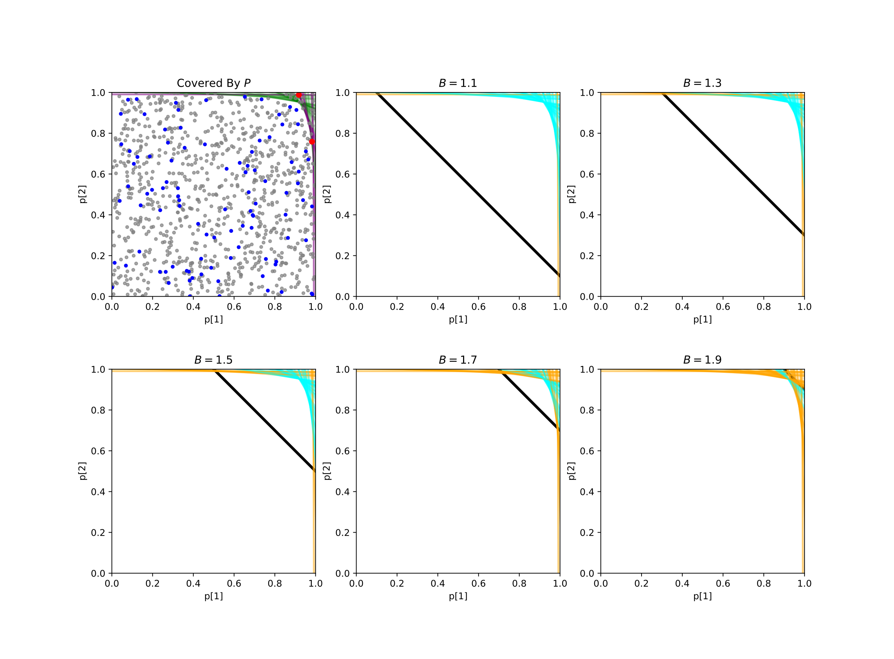
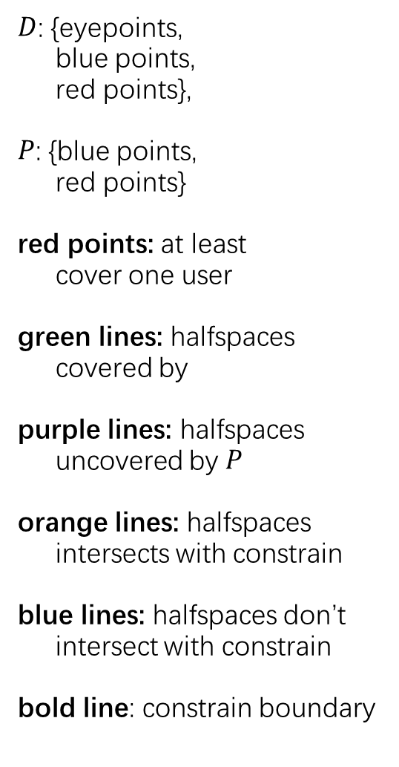
$D$: {eyepoints,
blue points,
red points},
$P$: {blue points,
red points}
red points: at least
cover one user
green lines: halfspaces
covered by
purple lines: halfspaces
uncovered by $P$
orange lines: halfspaces
intersects with constrain
blue lines: halfspaces don’t
intersect with constrain
bold line: constrain boundary

Slide 3
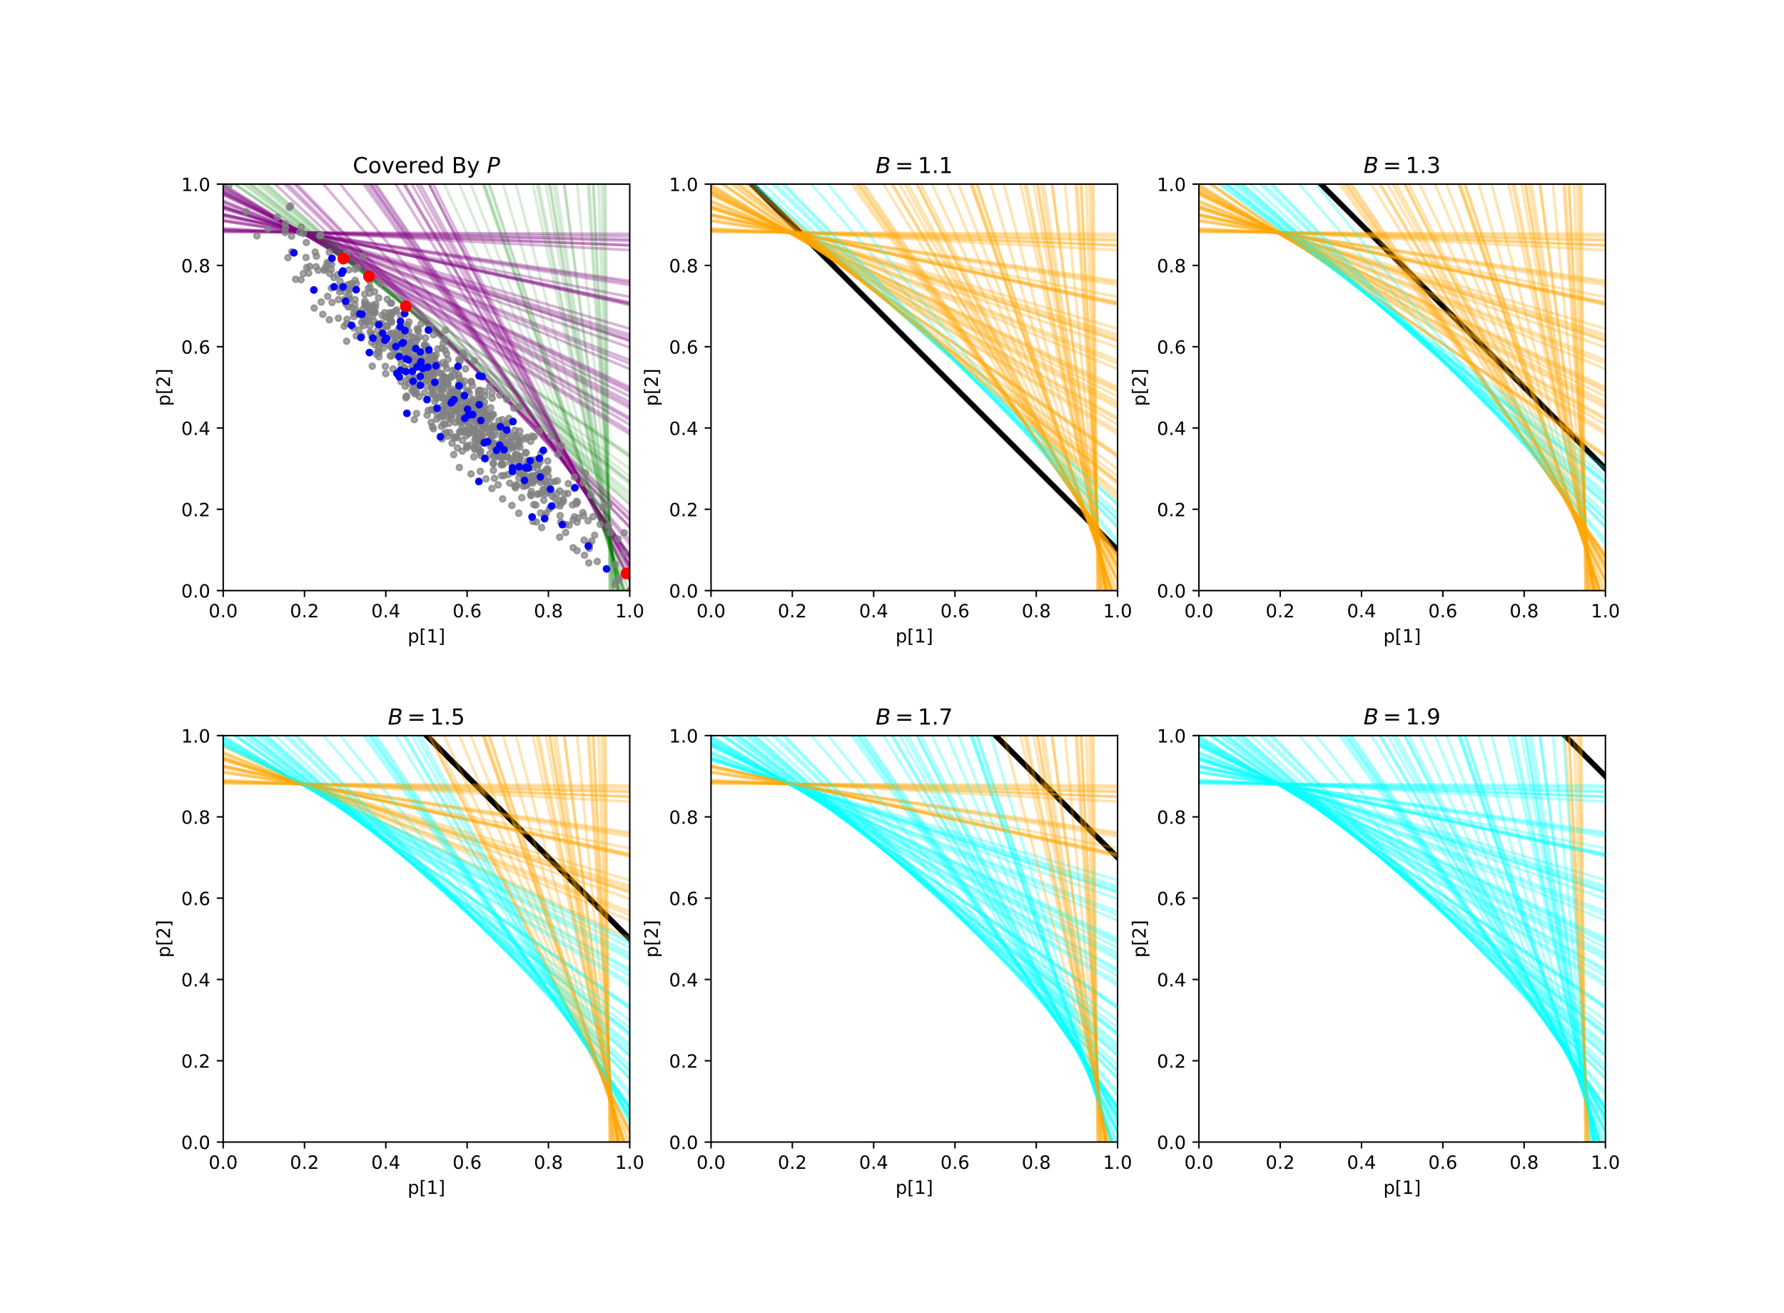
$D$: {eyepoints,
blue points,
red points},
$P$: {blue points,
red points}
red points: at least
cover one user
green lines: halfspaces
covered by
purple lines: halfspaces
uncovered by $P$
orange lines: halfspaces
intersects with constrain
blue lines: halfspaces don’t
intersect with constrain
bold line: constrain boundary

Slide 4
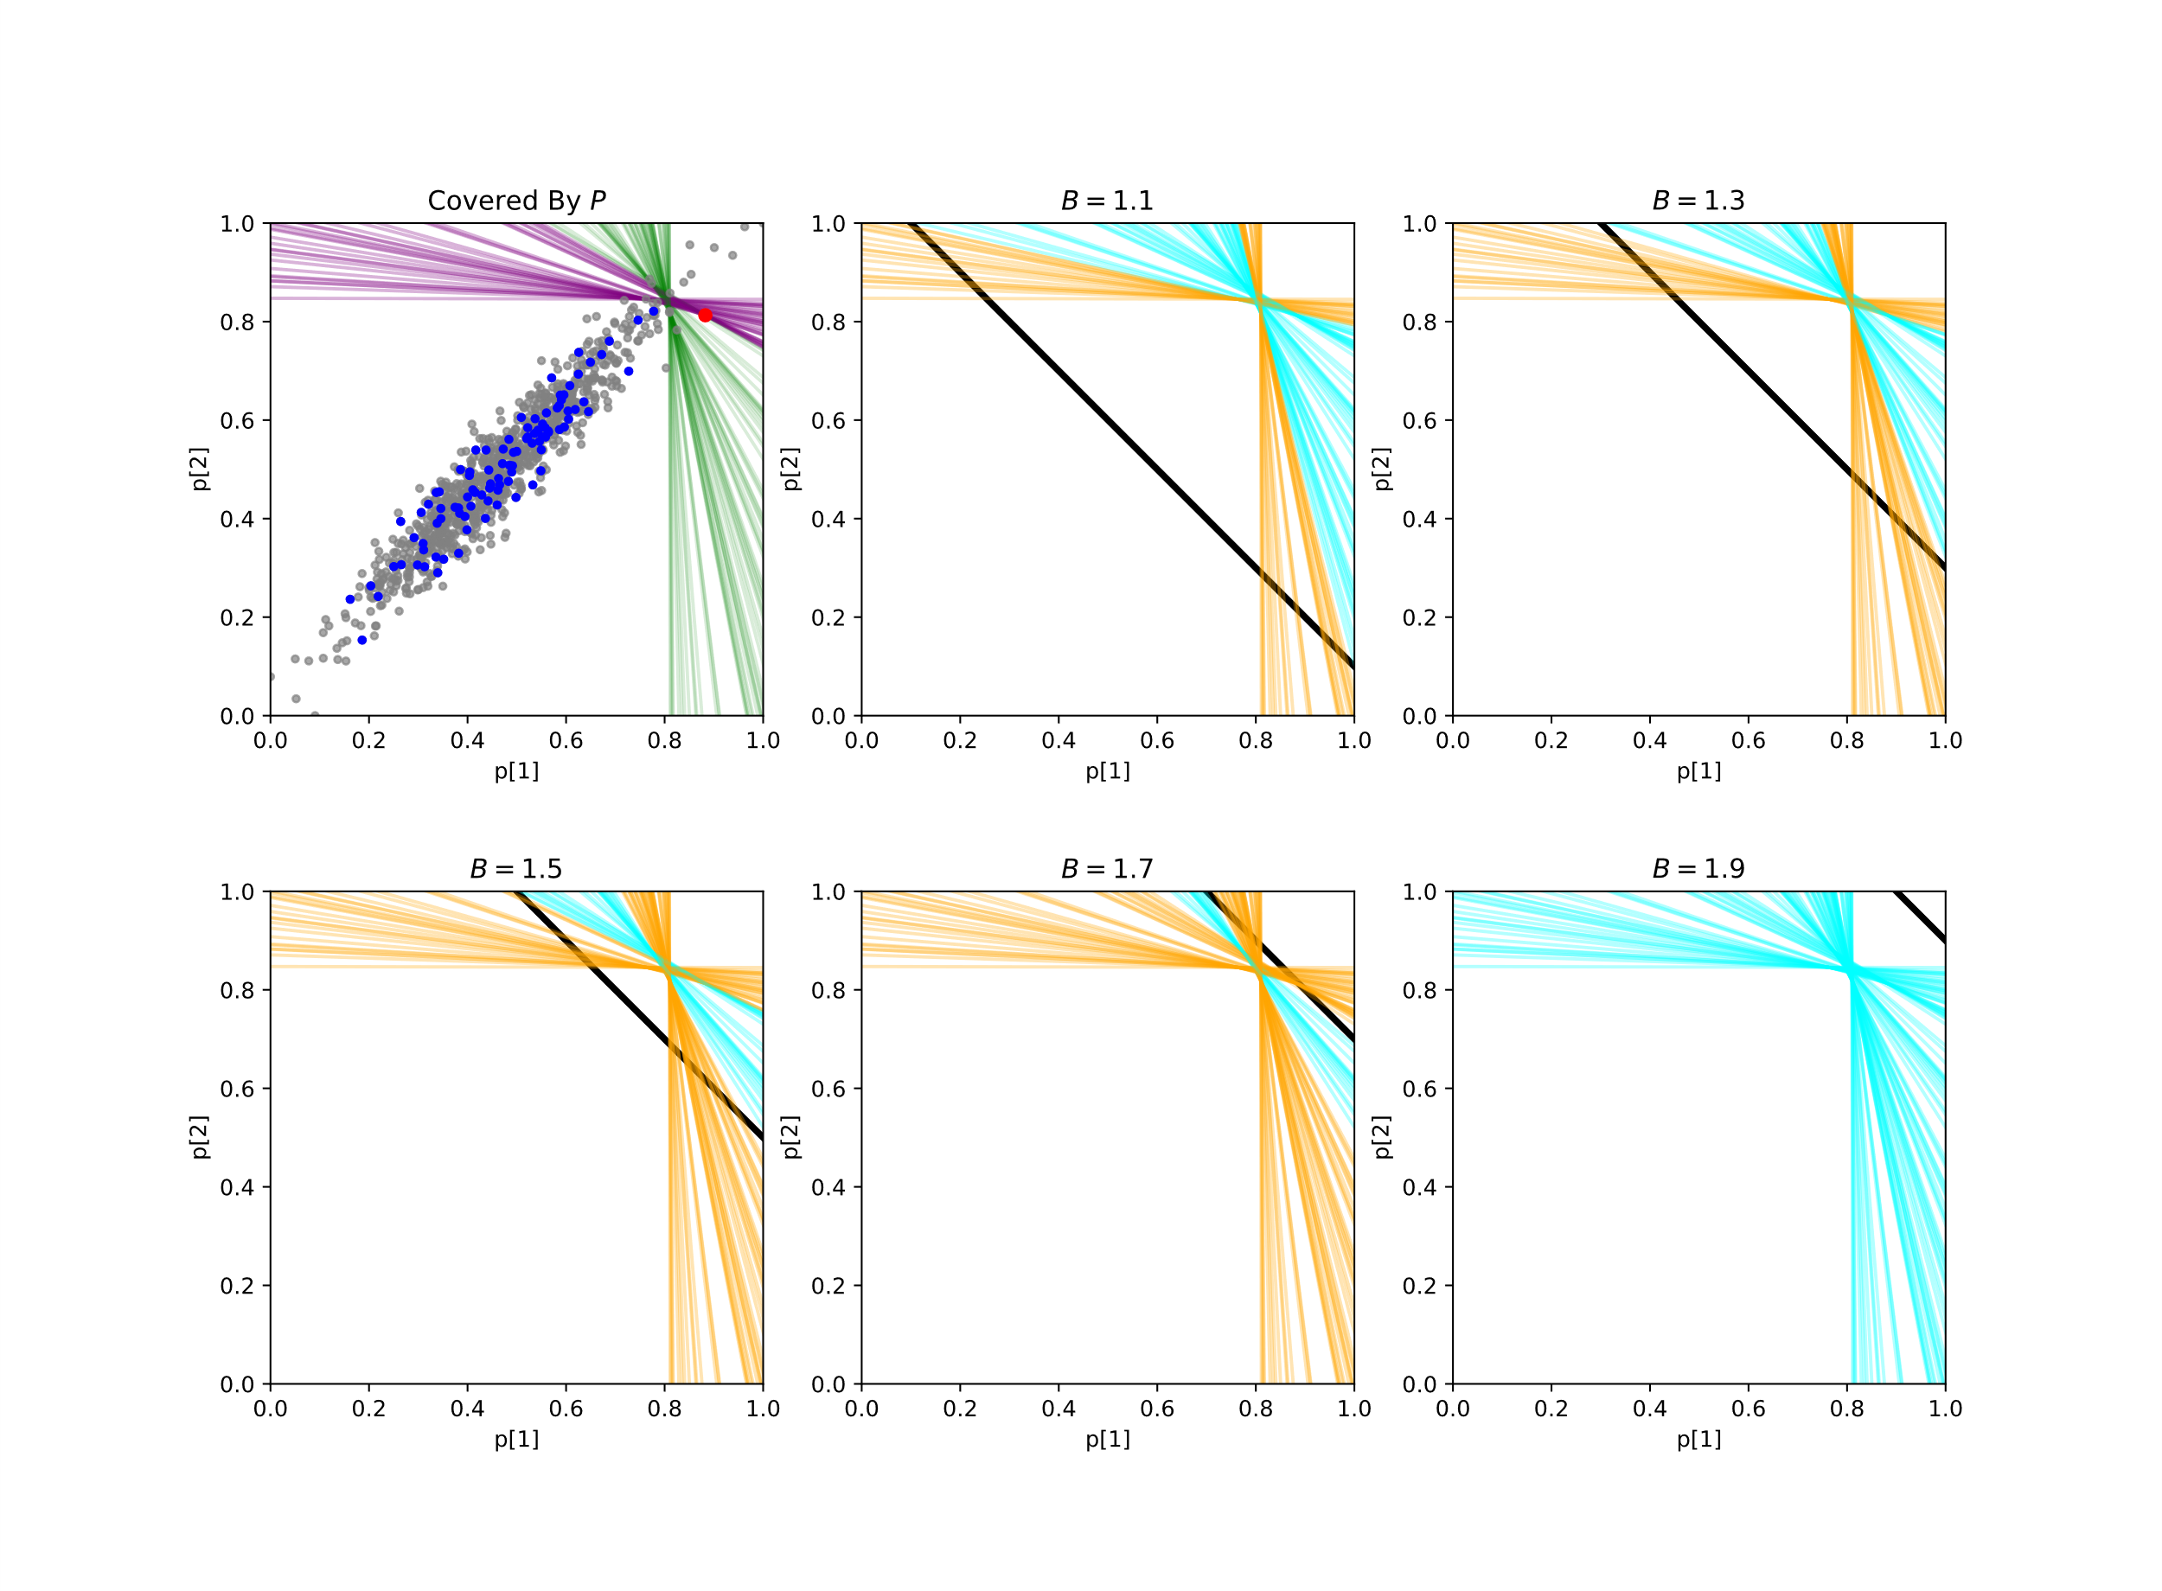
$D$: {eyepoints,
blue points,
red points},
$P$: {blue points,
red points}
red points: at least
cover one user
green lines: halfspaces
covered by
purple lines: halfspaces
uncovered by $P$
orange lines: halfspaces
intersects with constrain
blue lines: halfspaces don’t
intersect with constrain
bold line: constrain boundary

Slide 5
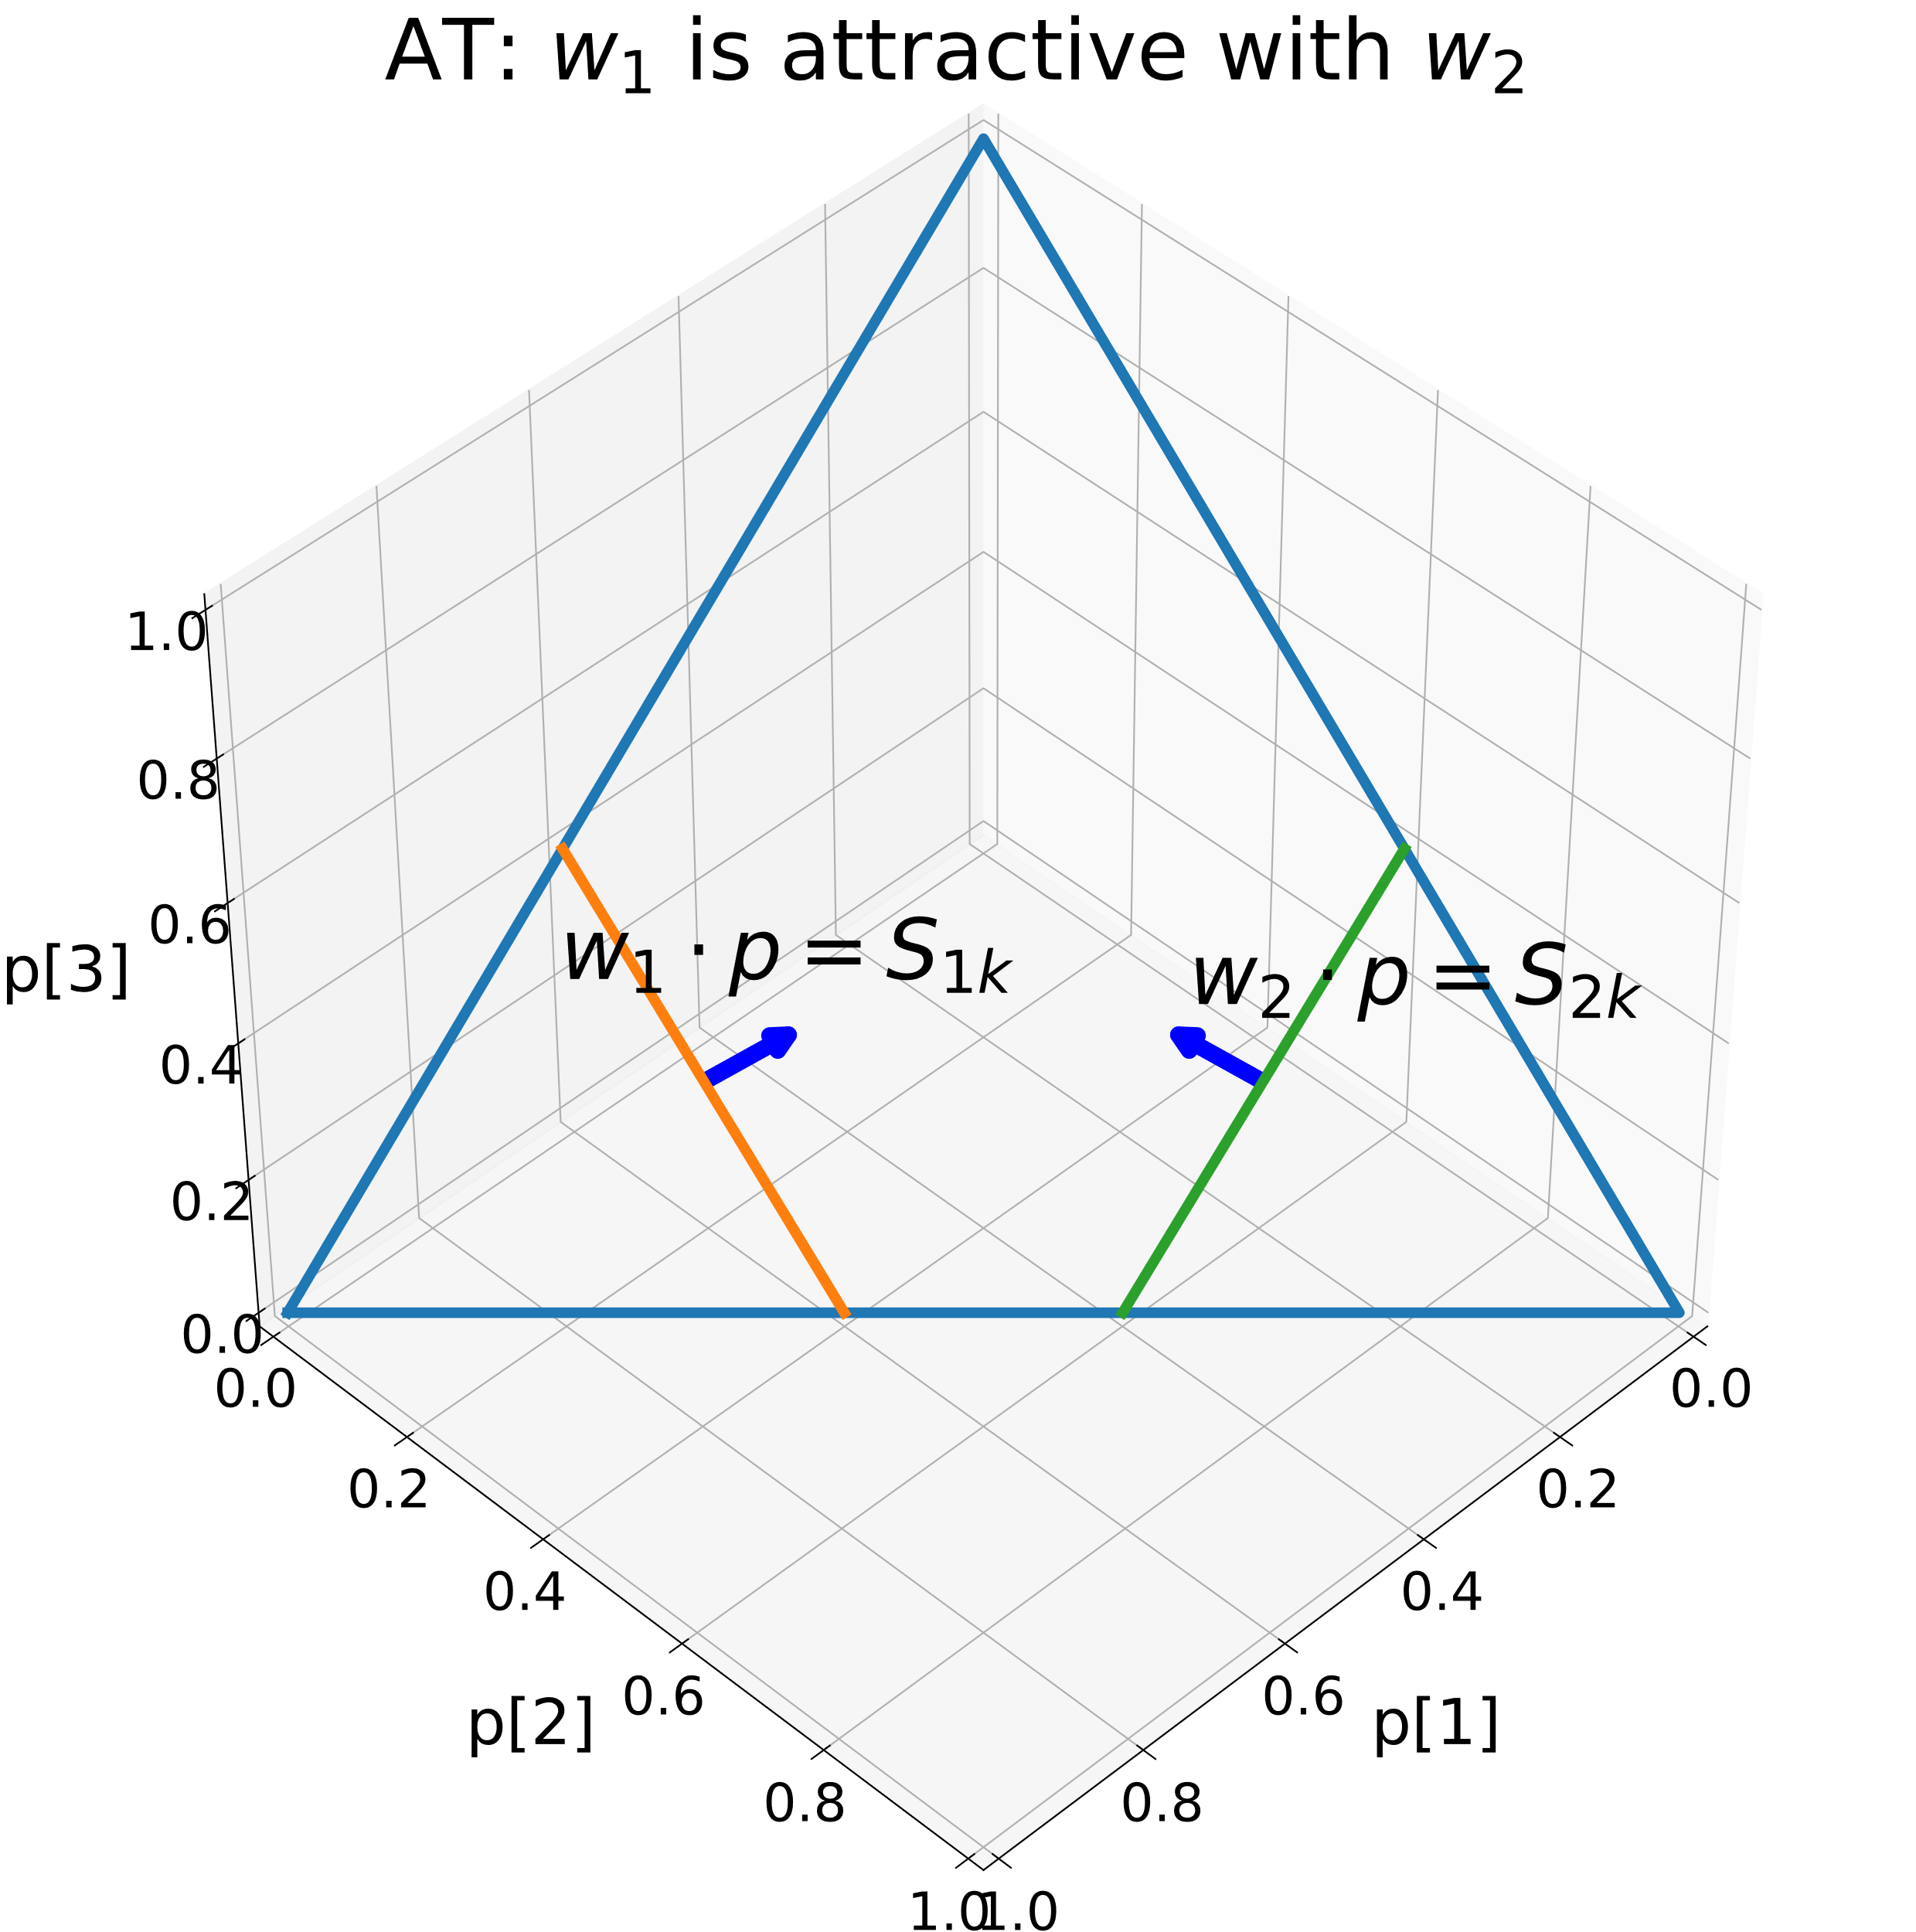
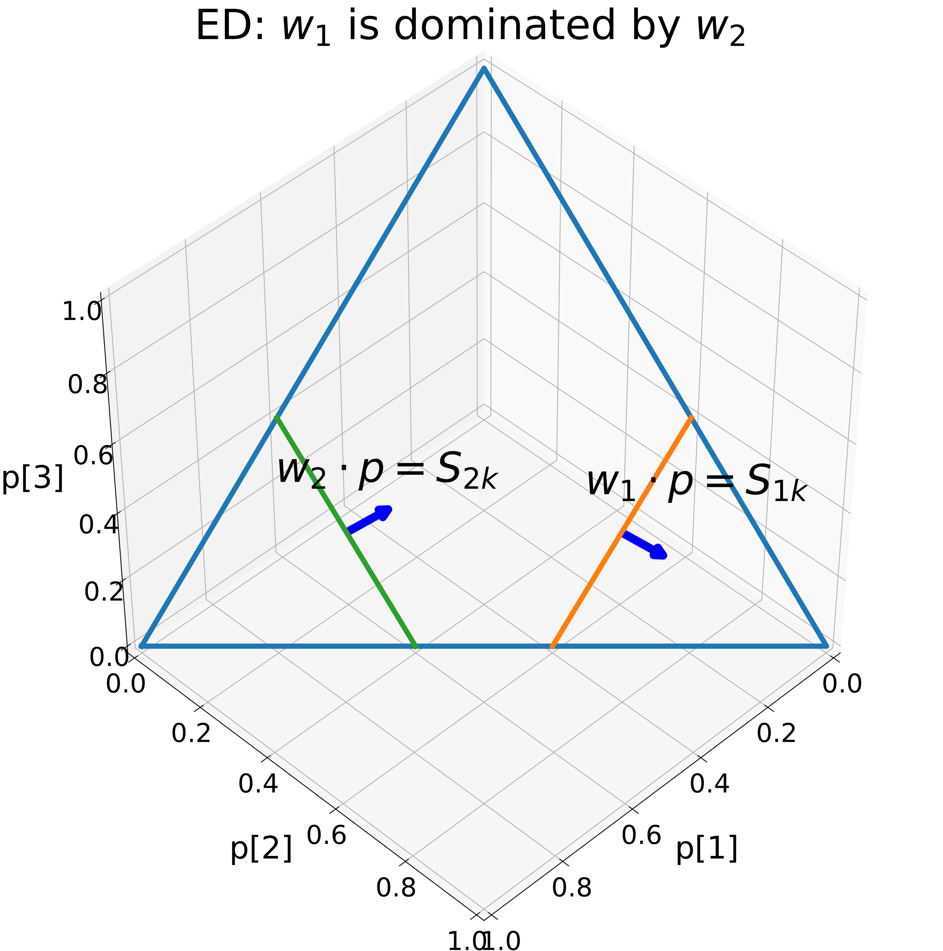
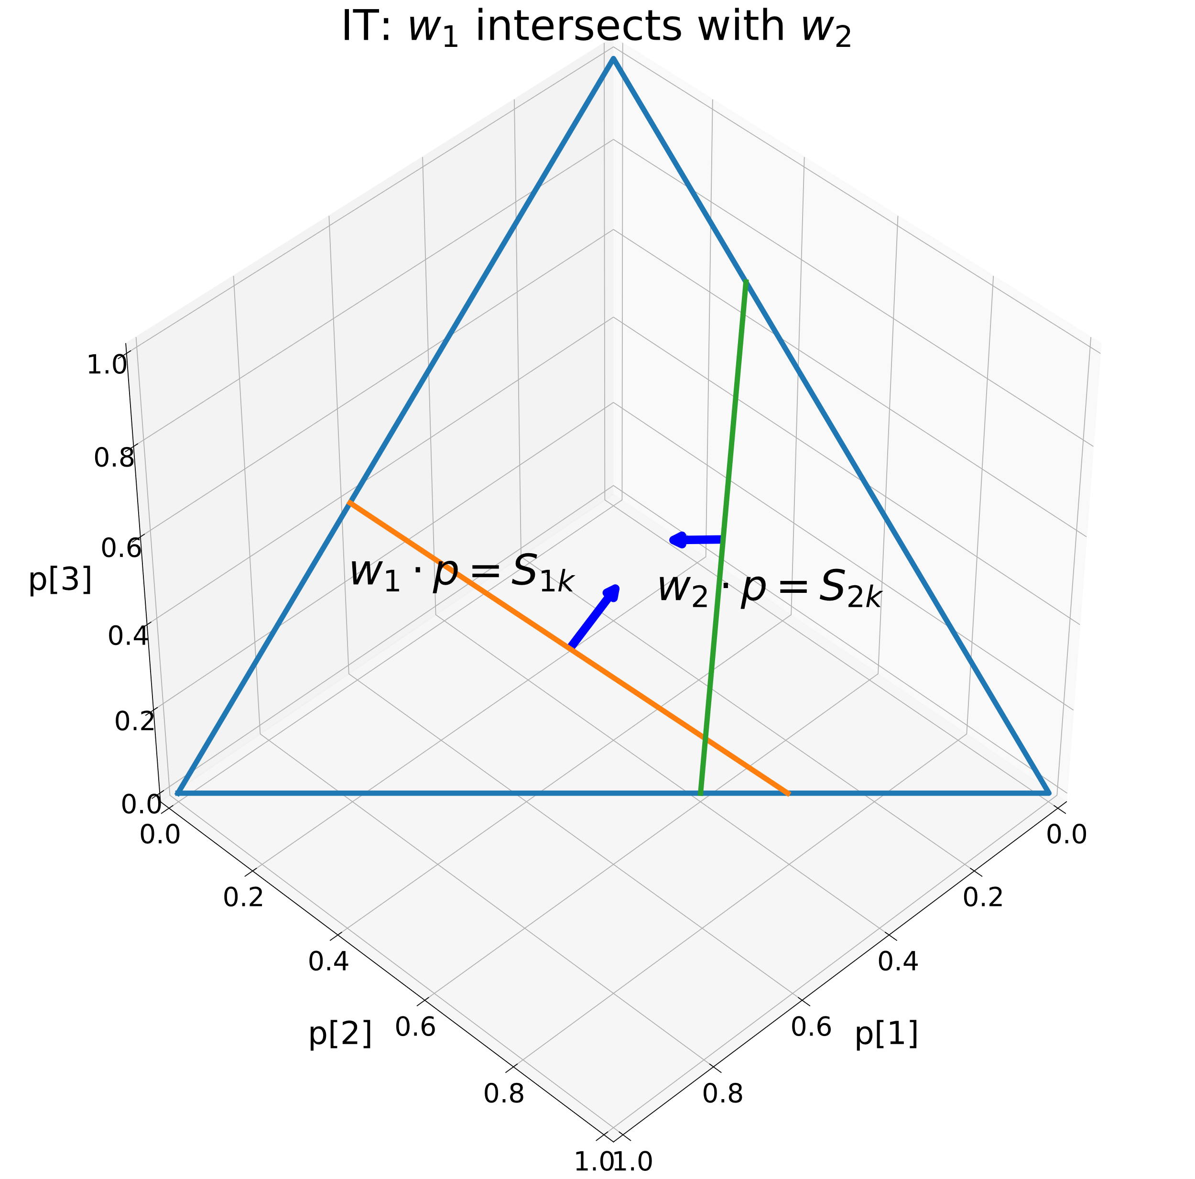
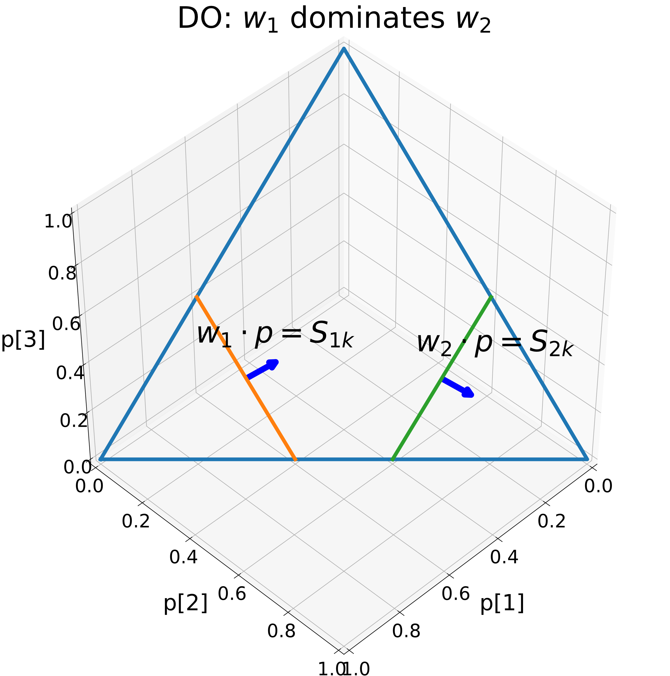
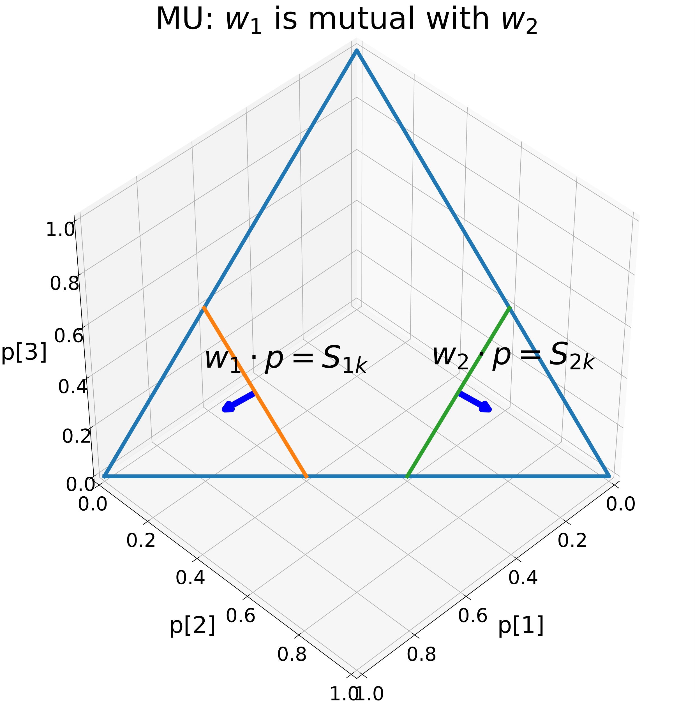
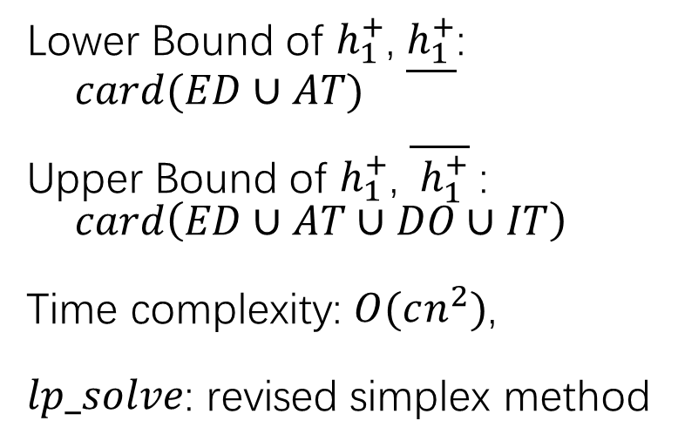
Lower Bound of $h_{1}^{+}$, $\underline{h_{1}^{+}}$:
$card(ED∪AT)$
Upper Bound of $h_{1}^{+}$, $\overline{ h_{1}^{+}}$:
$card\left(ED∪AT∪DO∪IT\right)$
Time complexity: $O(cn^{2})$,
$lp_solve$: revised simplex method

Slide 6
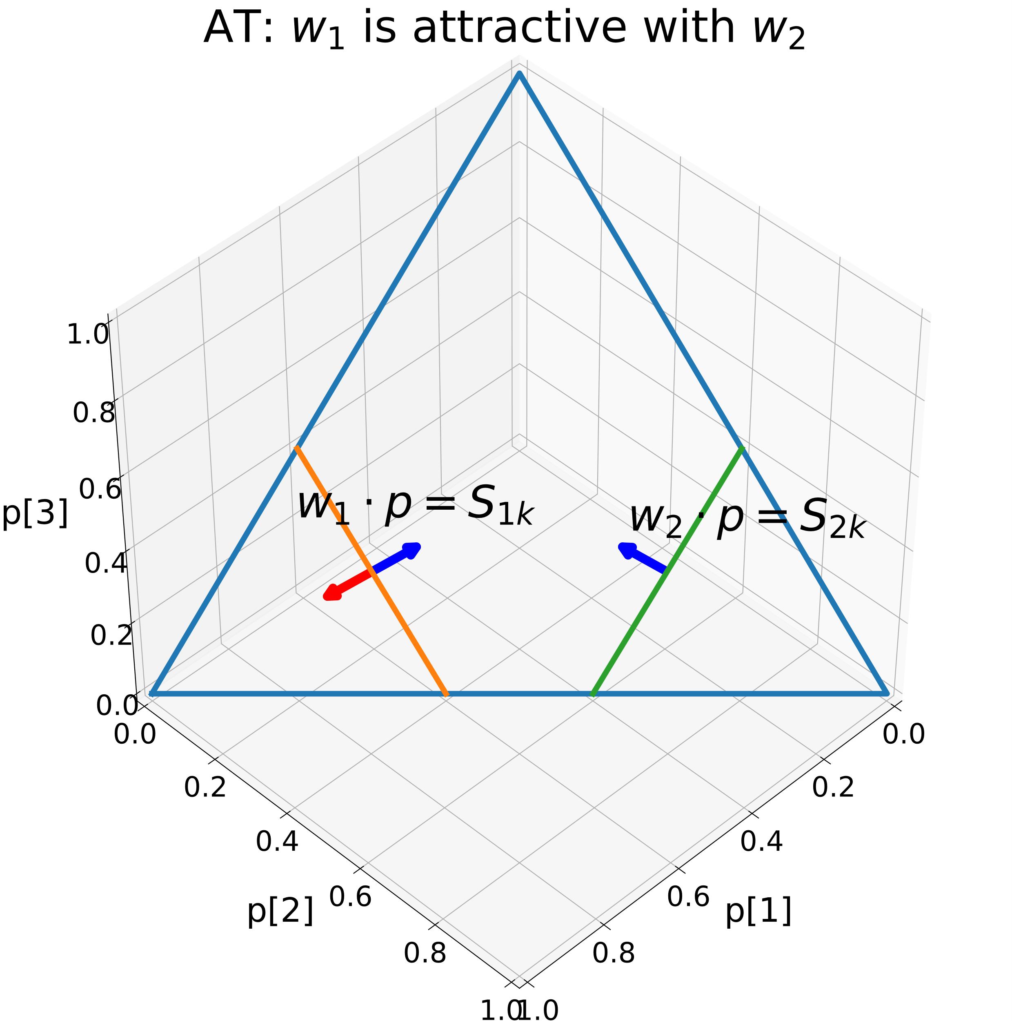
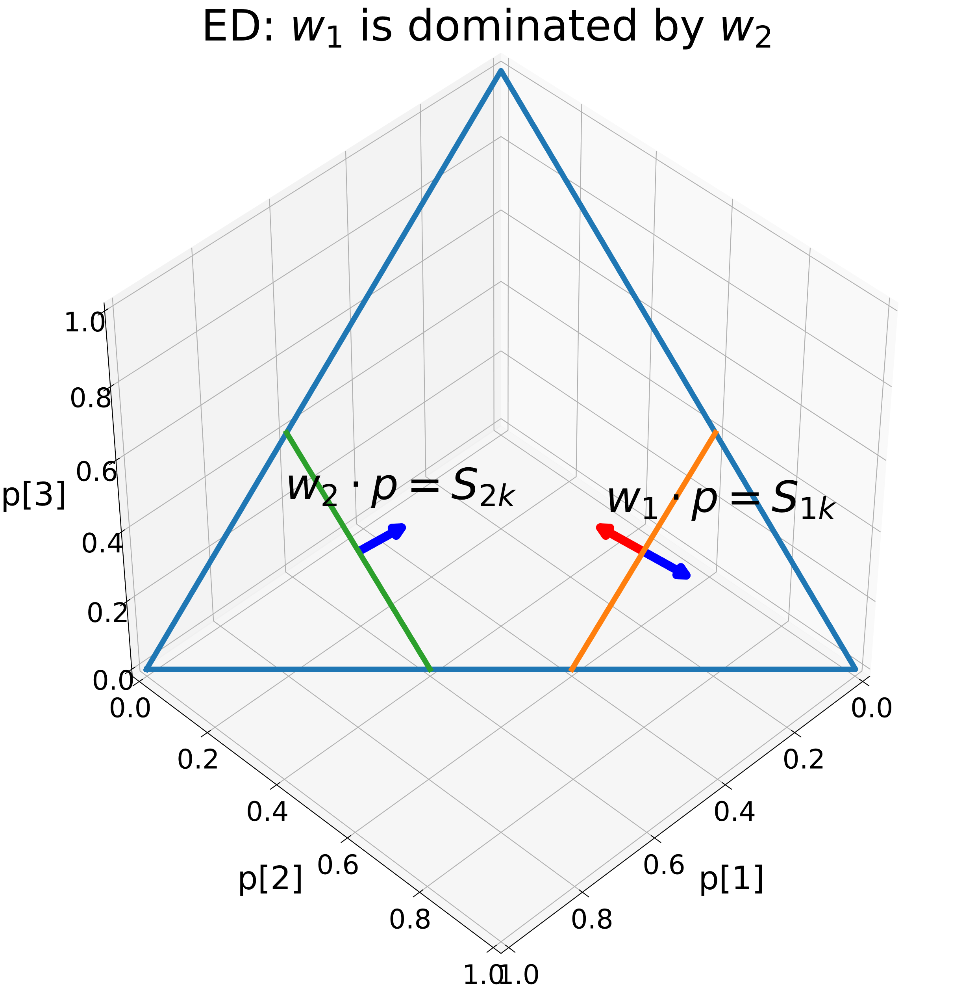
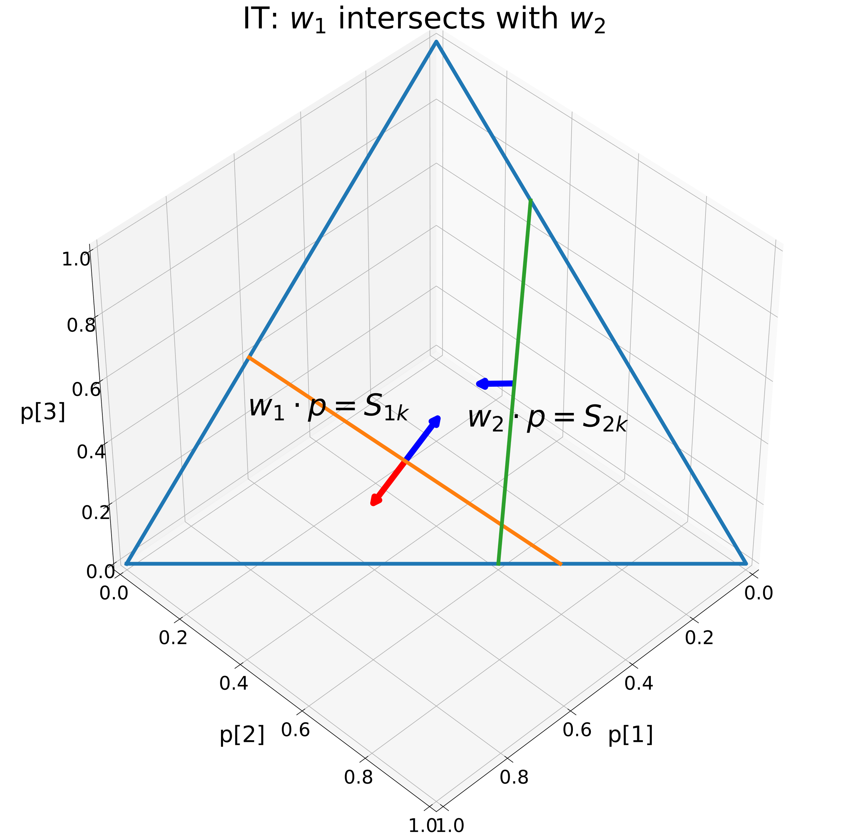
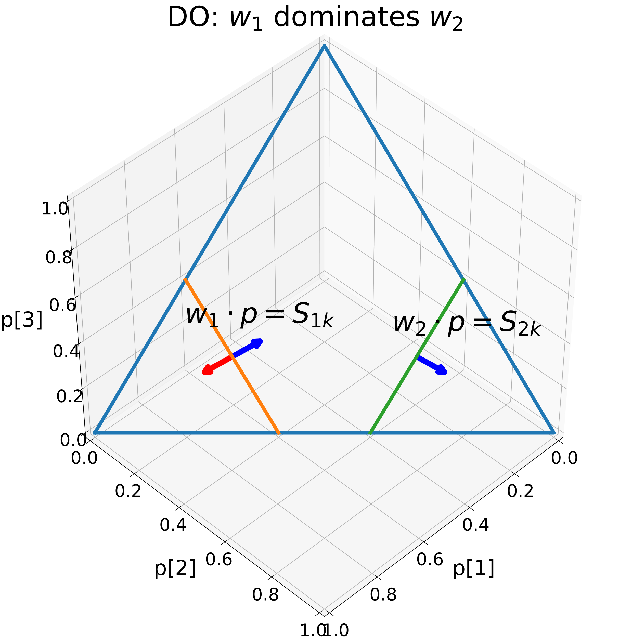
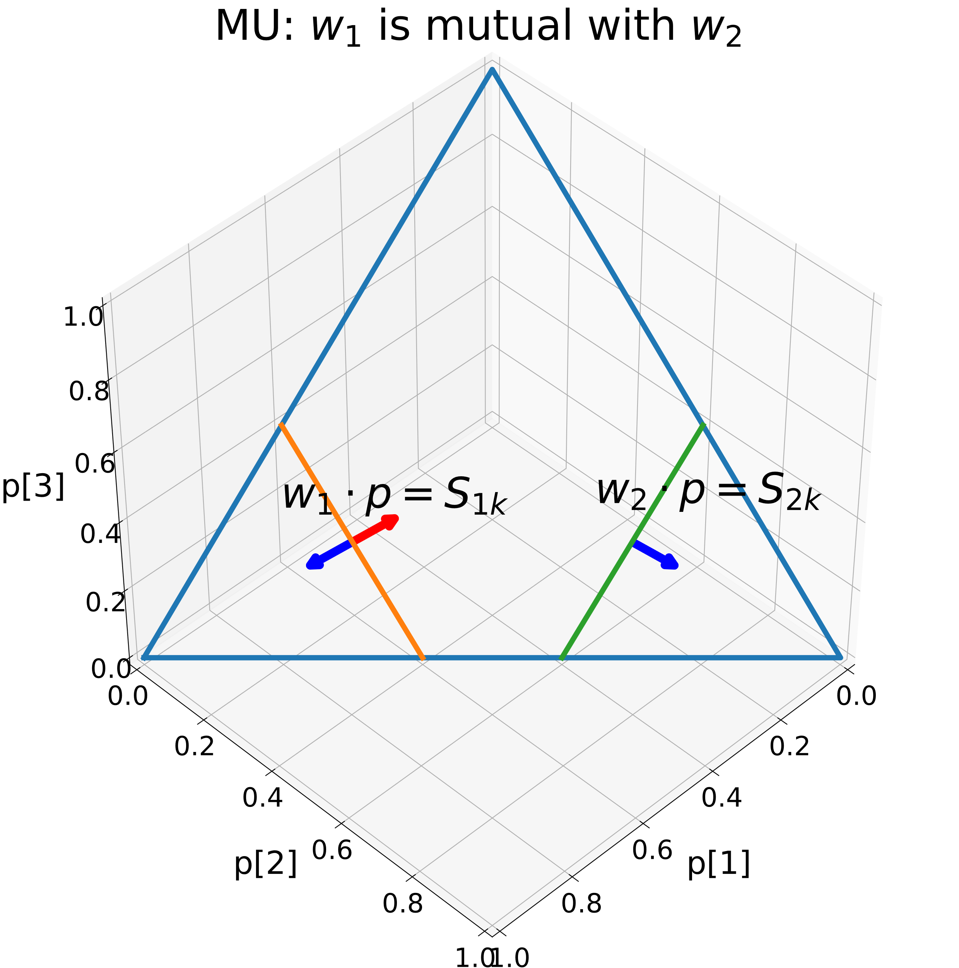
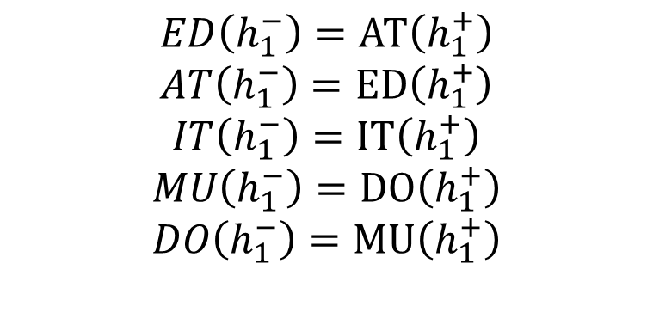
$$ED\left(h_{1}^{−}\right)=AT\left(h_{1}^{+}\right)$$
$$AT\left(h_{1}^{−}\right)=ED\left(h_{1}^{+}\right)$$
$$IT\left(h_{1}^{−}\right)=IT\left(h_{1}^{+}\right)$$
$$MU\left(h_{1}^{−}\right)=DO\left(h_{1}^{+}\right)$$
$$DO\left(h_{1}^{−}\right)=MU\left(h_{1}^{+}\right)$$

Slide 7
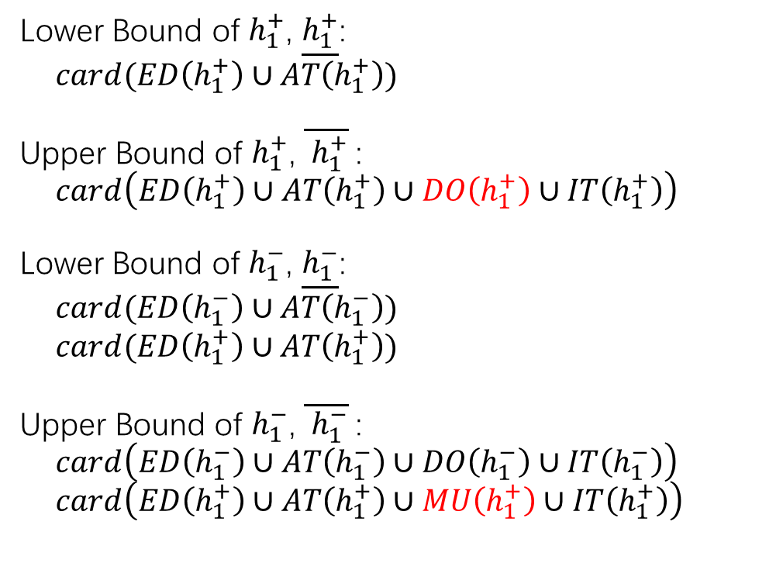
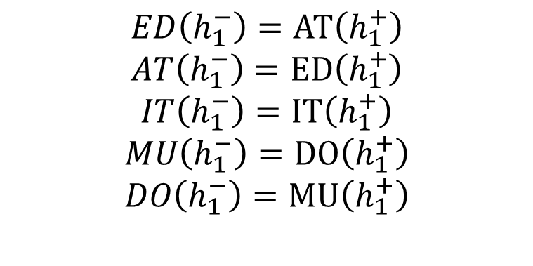
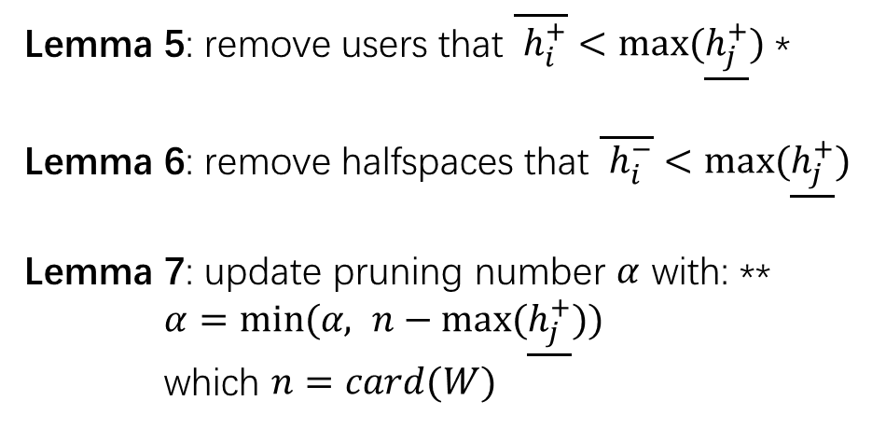
Lower Bounds and Upper bounds
$$ED\left(h_{1}^{−}\right)=AT\left(h_{1}^{+}\right)$$
$$AT\left(h_{1}^{−}\right)=ED\left(h_{1}^{+}\right)$$
$$IT\left(h_{1}^{−}\right)=IT\left(h_{1}^{+}\right)$$
$$MU\left(h_{1}^{−}\right)=DO\left(h_{1}^{+}\right)$$
$$DO\left(h_{1}^{−}\right)=MU\left(h_{1}^{+}\right)$$
Lower Bound of $h_{1}^{+}$, $\underline{h_{1}^{+}}$:
$card(ED\left(h_{1}^{+}\right)∪AT\left(h_{1}^{+}\right))$
Upper Bound of $h_{1}^{+}$, $\overline{ h_{1}^{+}}$:
$card\left(ED\left(h_{1}^{+}\right)∪AT\left(h_{1}^{+}\right)∪DO\left(h_{1}^{+}\right)∪IT\left(h_{1}^{+}\right)\right)$
Lower Bound of $h_{1}^{−}$, $\underline{h_{1}^{−}}$:
$card(ED\left(h_{1}^{−}\right)∪AT\left(h_{1}^{−}\right))$
$card(ED\left(h_{1}^{+}\right)∪AT\left(h_{1}^{+}\right))$
Upper Bound of $h_{1}^{−}$, $\overline{ h_{1}^{−}}$:
$card\left(ED\left(h_{1}^{−}\right)∪AT\left(h_{1}^{−}\right)∪DO\left(h_{1}^{−}\right)∪IT\left(h_{1}^{−}\right)\right)$
$card\left(ED\left(h_{1}^{+}\right)∪AT\left(h_{1}^{+}\right)∪MU\left(h_{1}^{+}\right)∪IT\left(h_{1}^{+}\right)\right)$
Lemma 5: remove users that $\overline{ h_{i}^{+}}<max⁡(\underline{h_{j}^{+}})$ *
Lemma 6: remove halfspaces that $\overline{ h_{i}^{−}}<max⁡(\underline{h_{j}^{+}})$
Lemma 7: update pruning number $α$ with: **
$α=min⁡(α, n−max⁡(\underline{h_{j}^{+}}))$
which $n=card(W)$

Slide 8
TODO
review paper
毕设PPT
修改论文
更严格的的upper bound, lower bound
真实的数据集， 真实的产品与真实的用户对应
读广念论文
yufei的两篇论文
3d的可视化

